Slide 1

Error Mitigation
Rajesh Sathya Kumar

Slide 2
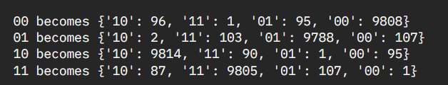
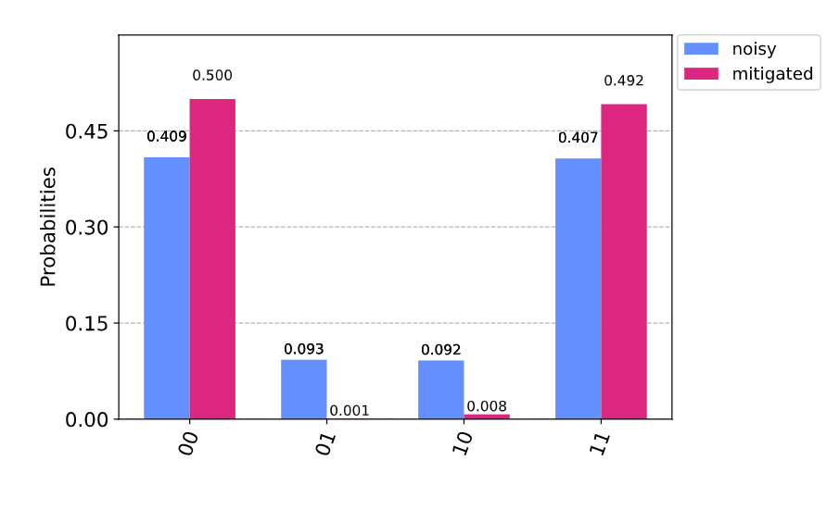
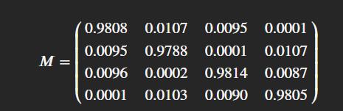


Measurement Error Mitigation
A simpler form of noise is that occurring during final measurement. This can be easily mitigated using Qiskit functions, complete_meas_cal, CompleteMeasFitter.

Slide 3
Quantum Tomography
Quantum tomography or quantum state tomography is the process by which a quantum state is reconstructed using measurements on an ensemble of identical quantum states.
The Problem with Measurement Error Mitigation and Quantum Tomography is the non-scalability of the methods with respect to the number of qubits as they tend to be exponential

Slide 4
Randomized benchmarking
Clifford Gates: In quantum computing, the Clifford Group is a set of gates defined by the property that they always transform Pauli’s to Pauli’s. Step 1: Generate RB sequences
Step 2: Execute the RB sequences (with some noise) Step 3: Get statistics about the survival probabilities Step 4: Find the averaged sequence fidelity Step 5: Fit the results

Slide 5
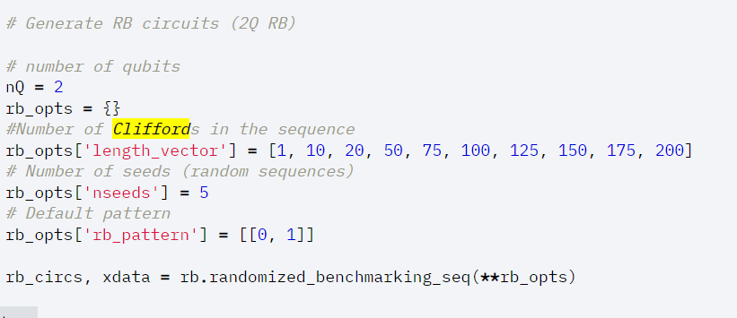
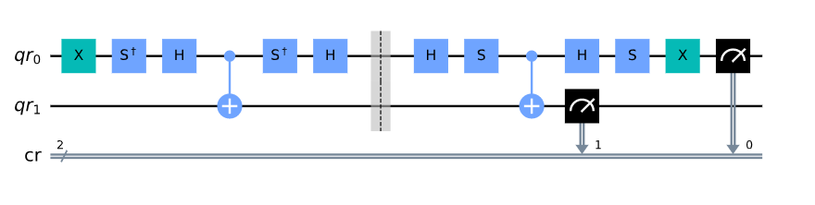
Generate RB Sequences

Slide 6
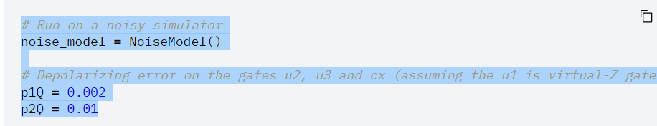
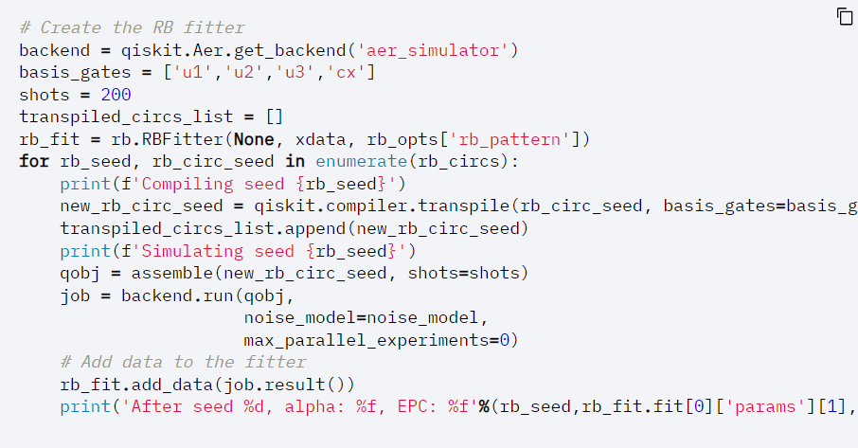
Execute the RB sequences with some noise
Get statistics about the survival probabilities
Find the averaged sequence fidelity
Fit the results

Slide 7
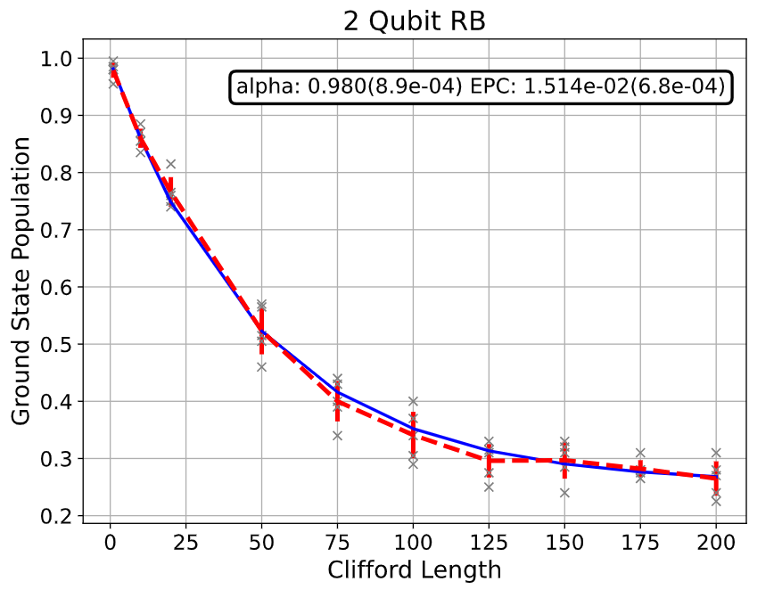


Final Noise Model
alpha – avg error parameter
Error Per Clifford

Slide 8
Mitiq
Mitiq is a Python toolkit for implementing error mitigation techniques on quantum computers.
Mitiq implements some techniques like
Zero Noise Extrapolation
Probabilitistic Error Cancellation
Clifford Data Regression

Slide 9
References
Easwar Magesan, J. M. Gambetta, and Joseph Emerson, Robust randomized benchmarking of quantum processes, https://arxiv.org/pdf/1009.3639
Easwar Magesan, Jay M. Gambetta, and Joseph Emerson, Characterizing Quantum Gates via Randomized Benchmarking, https://arxiv.org/pdf/1109.6887
A. D. C'orcoles, Jay M. Gambetta, Jerry M. Chow, John A. Smolin, Matthew Ware, J. D. Strand, B. L. T. Plourde, and M. Steffen, Process verification of two-qubit quantum gates by randomized benchmarking, https://arxiv.org/pdf/1210.7011
Jay M. Gambetta, A. D. C´orcoles, S. T. Merkel, B. R. Johnson, John A. Smolin, Jerry M. Chow, Colm A. Ryan, Chad Rigetti, S. Poletto, Thomas A. Ohki, Mark B. Ketchen, and M. Steffen, Characterization of addressability by simultaneous randomized benchmarking, https://arxiv.org/pdf/1204.6308
David C. McKay, Sarah Sheldon, John A. Smolin, Jerry M. Chow, and Jay M. Gambetta, Three Qubit Randomized Benchmarking, https://arxiv.org/pdf/1712.06550

Slide 10
Progress
Sent a first draft of my document with all the progress till now.
Working on Determining Quantum Volume for Hybrid Neural Networks
Continue learning more techniques on error mitigation

